Slide 1
Probability Distributions AME20216 – Lab I

Slide 2
Quadrature Encoders
A Quadrature encoder counts electrical pulses as slotted wheel passes through a photocell.
Measures angular position and speed.

Slide 3
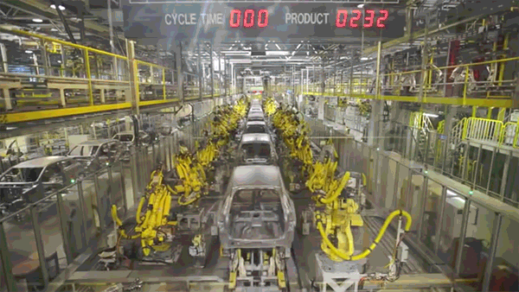
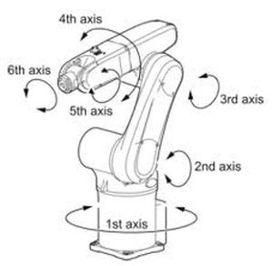
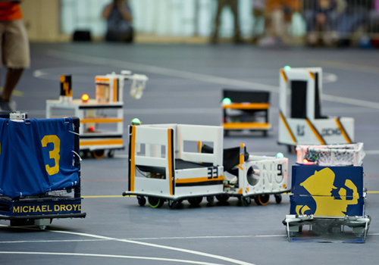
Orientation
Mechanical parts can rotate to various angles.
Robot football

Slide 4
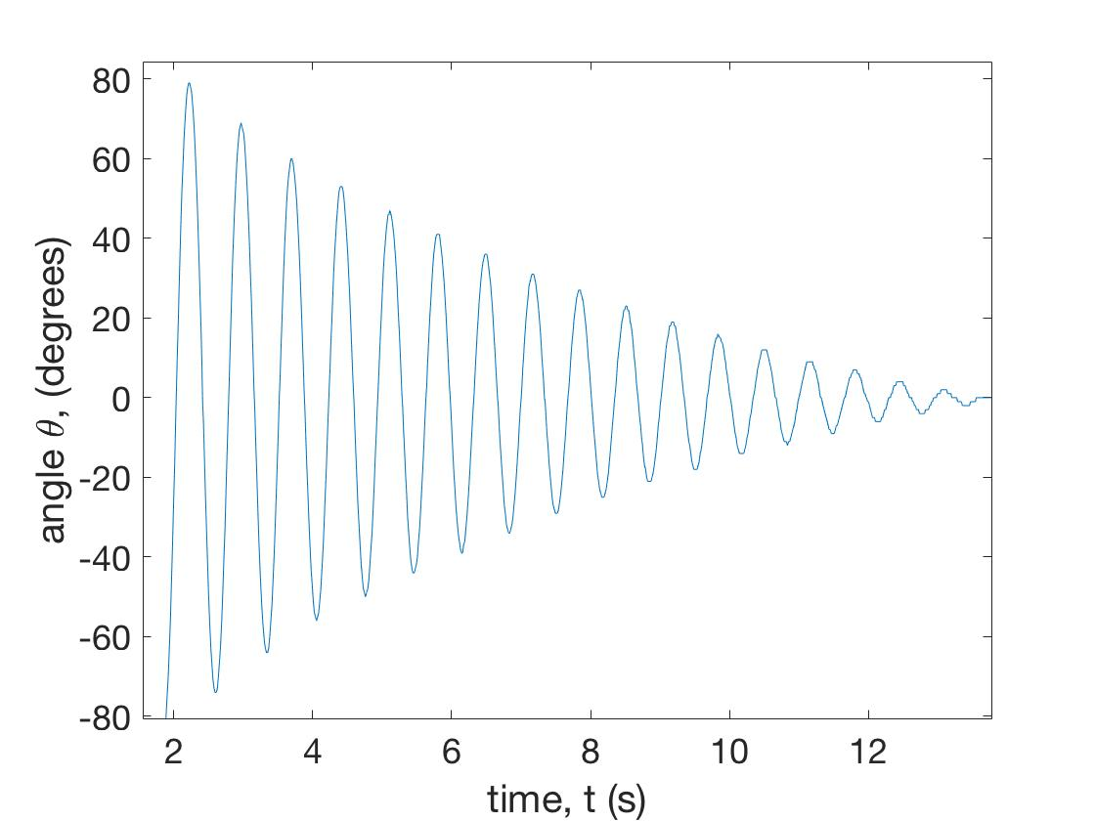
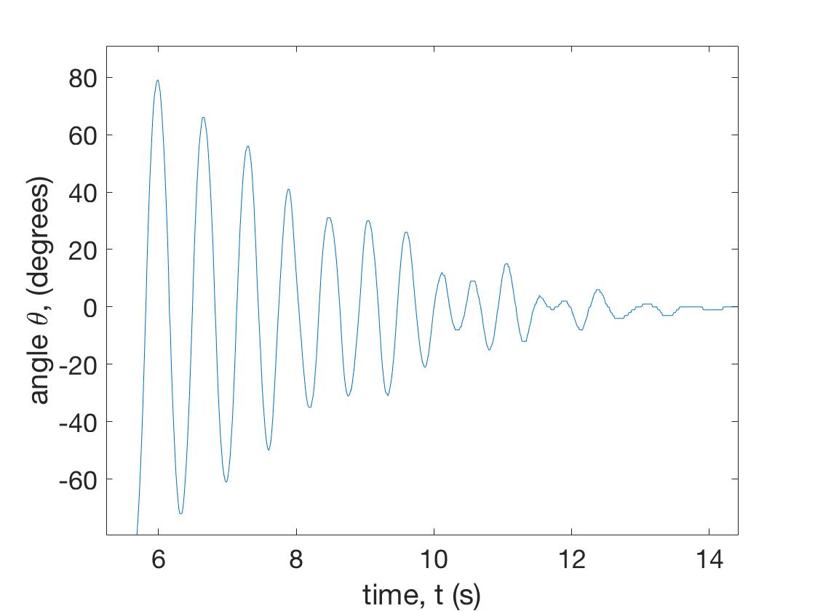
One degree of freedom: θ
Two degrees of freedom: θ₁ and θ₂

Slide 5

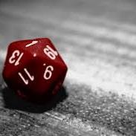


Unpredictable Systems

Slide 6
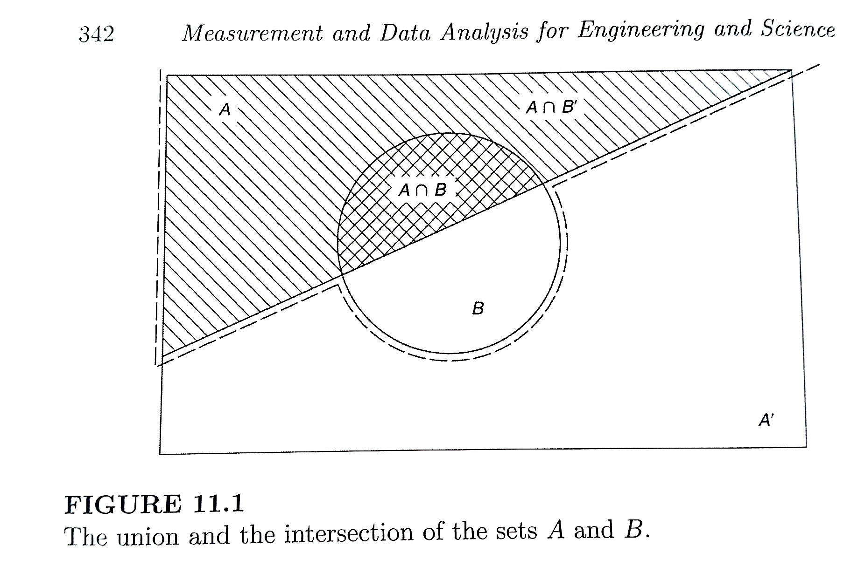
Probability – Venn Diagrams
Intersection “AND”
Union “OR”

Slide 7

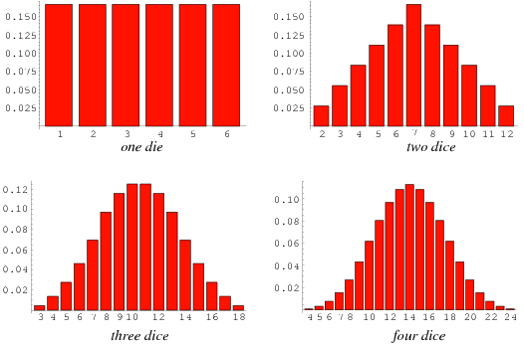
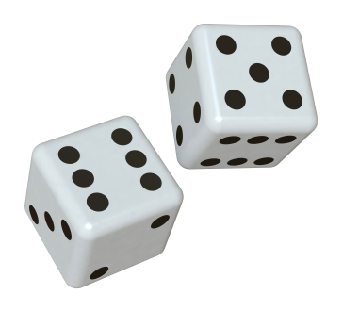
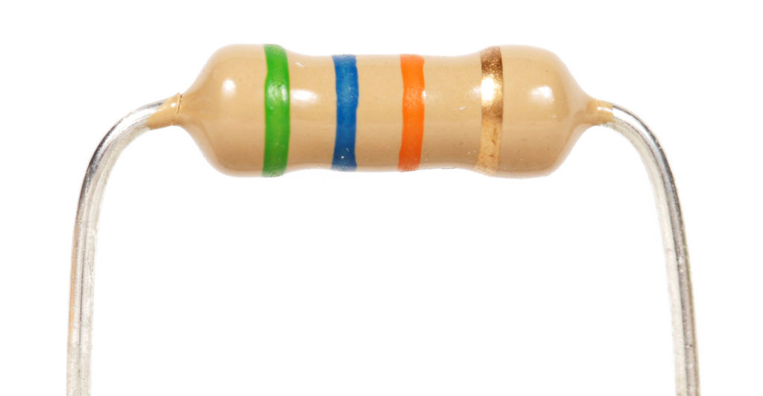
A12 – Monte Carlo Night!
Pair of Dice
Manufactured Resistors

Slide 8
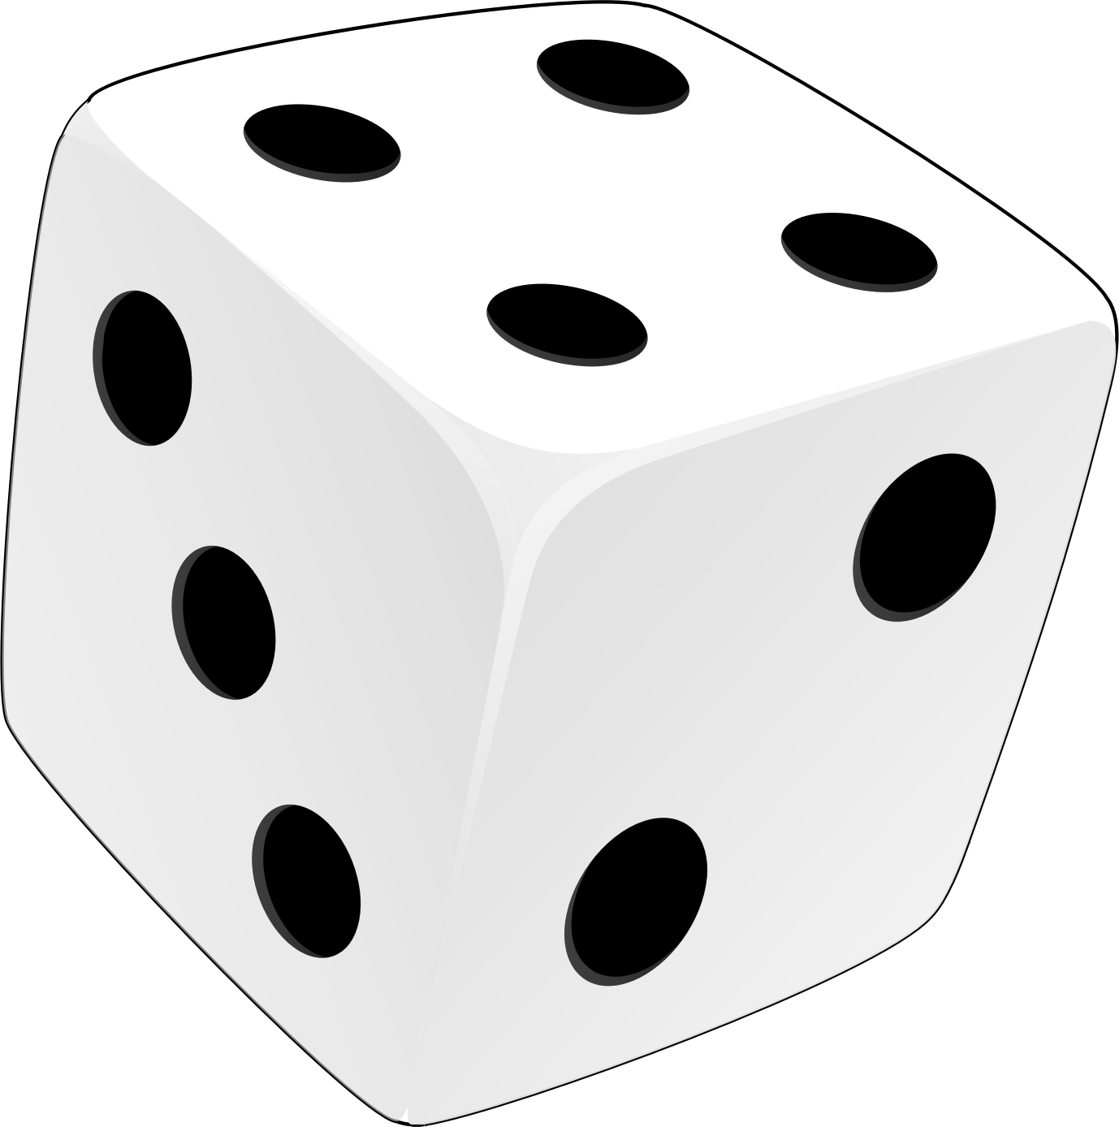
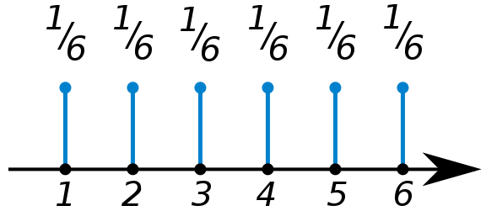
Discrete Probability Distributions
P(n) – Probability of observing the nth discrete value
P(n) =
n =
Normalization
Mean or “expected value”
<n> = 3.5

Slide 9
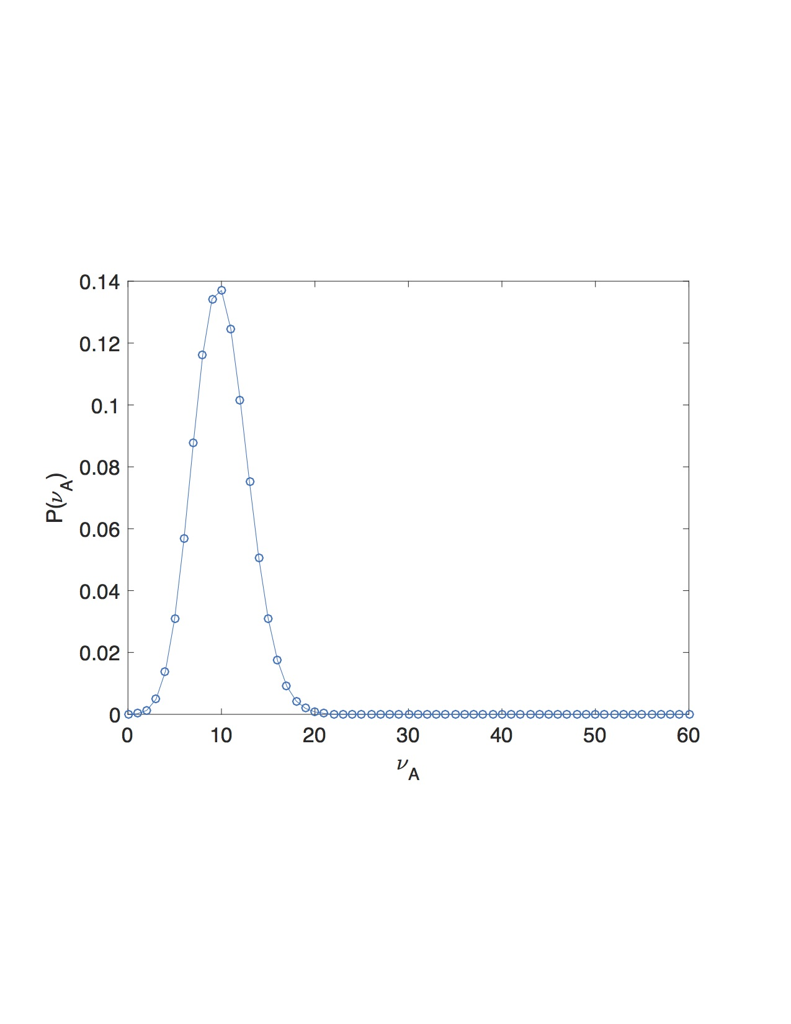
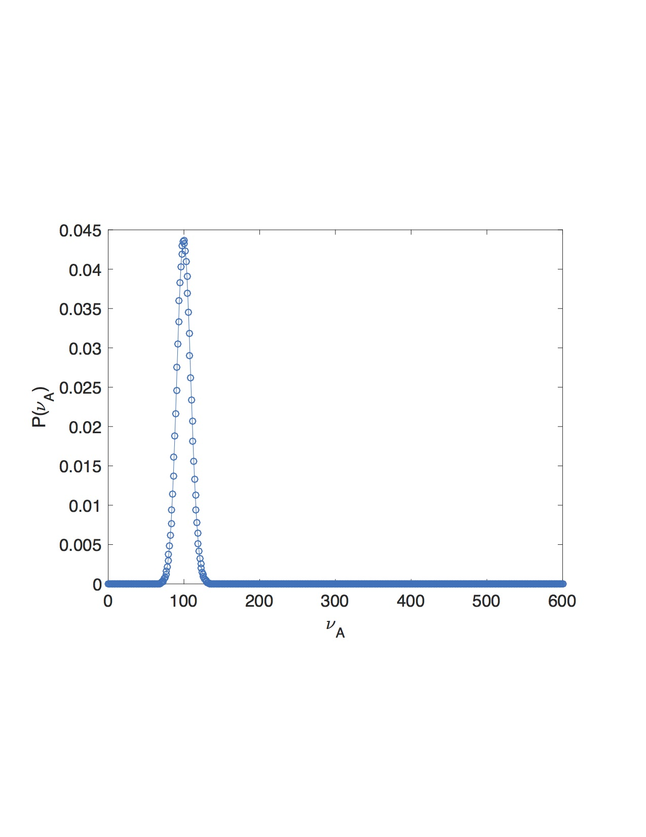
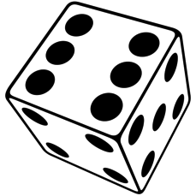
Binomial Distribution
Probability an event A occurs v_{A} times out of N trials, given the prob. of seeing it once is P(A).
N= 600
N= 60
P(A)=1/6
P(A)=1/6

Slide 10
Measuring Probability – Poisson Statistics
“Counting” experiments.
Uncertainty in Measured Probability
Measured Probability
N= 600
N= 60
P(A)=1/6
P(A)=1/6
“Statistical Convergence”

Slide 11


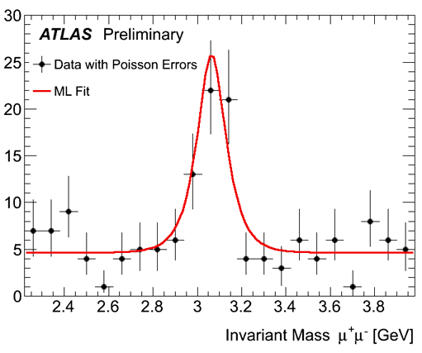
Measuring Probability – Poisson Statistics
“Counting” experiments.
http://www.bbc.com/news/world-us-canada-43818752

Slide 12
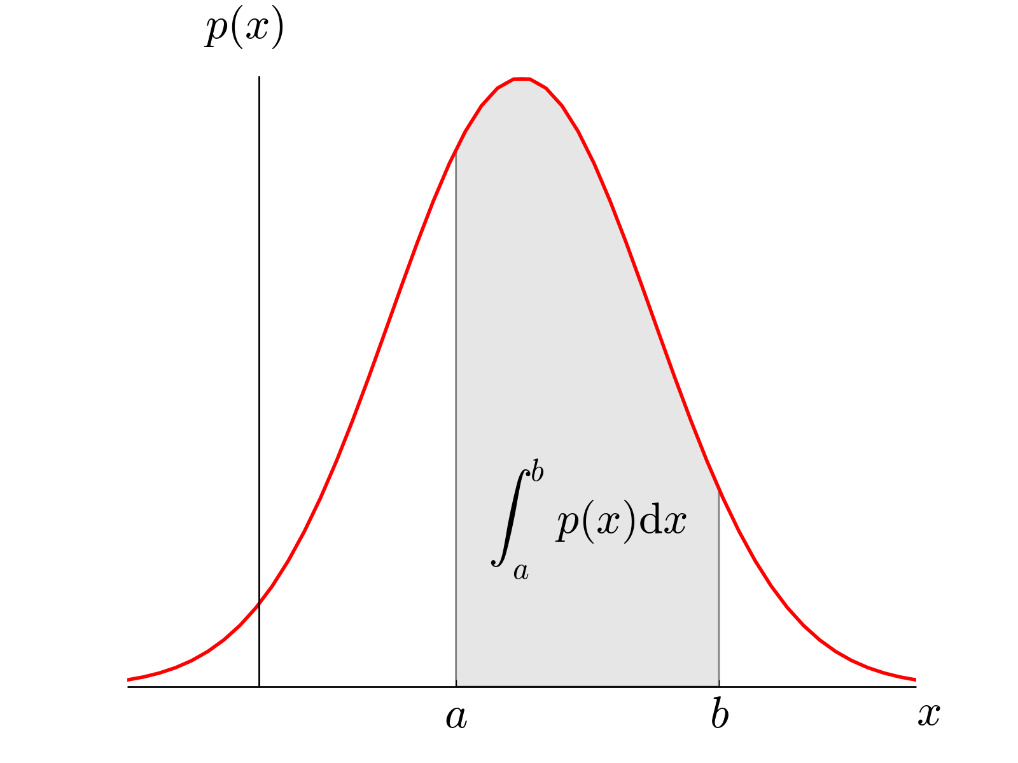
Continuous Probability Distributions
ρ(x) – Probability Density Function
Probability x is between a and b:

Slide 13
Central Limit Theorem
http://mathworld.wolfram.com/Dice.html

Slide 14
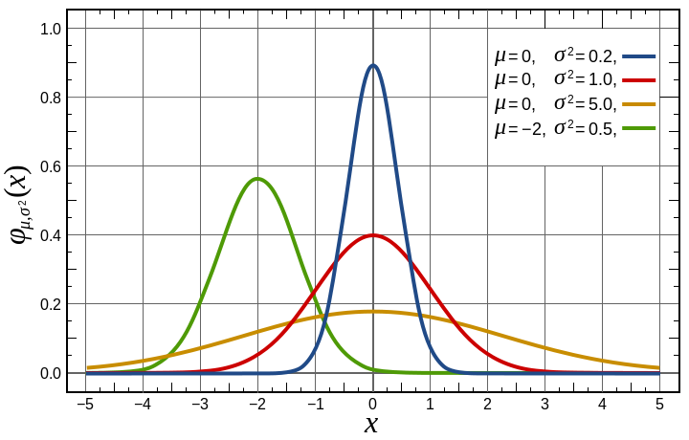
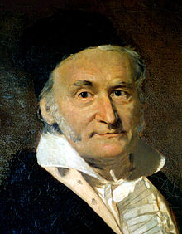
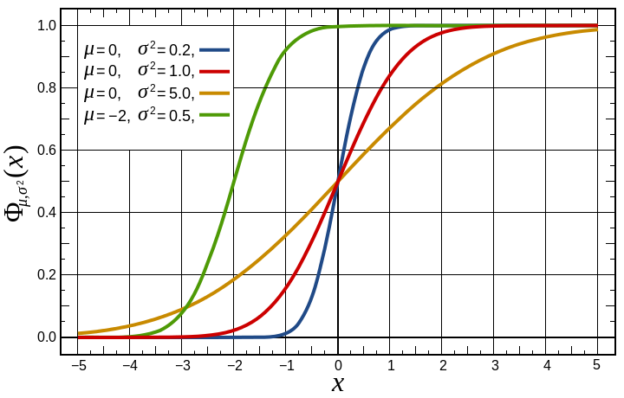
Gaussian Distribution
Gaussian PDF
Central Limit Theorem – For large N, most distributions become Gaussian
Gaussian CDF
Carl Friedrich Gauss (1777-1855)

Slide 15
Gaussian Distribution
Central Limit Theorem – For large N, most distributions become Gaussian
Gaussian PDF
Gaussian CDF

Slide 16
Z-table

